Slide 1
F1 Cars Performances
MENU
ANALYSIS
CONTACT
DS 2500
Final Project
Author : Prachi Aswani

Slide 2
GOAL
MENU
ANALYSIS
CONTACT
Data ANALYSIS
The central question guiding my analysis is: "What factors influence performance in Formula 1?" Through a deep dive into various dimensions of Formula 1 data, I aim to uncover the underlying factors that drive success on the racetrack.

Slide 3
TABLE OF CONTENT
Analysis 1
Analysis 2
01
02
Analysis 3
Analysis 4
03
04
MENU
ANALYSIS
CONTACT
Data ANALYSIS
Grid Position and Constructor causes Final Position
2013 V/S 2014 and 2021 V/S 2022 and both comparisions
Pitstops and Position on Performance
Total average points for country

Slide 4
INTRODUCTION
MENU
ANALYSIS
CONTACT
Data ANALYSIS
Utilizing a comprehensive data set encompassing results, races, drivers, constructors, and circuits data from Formula 1 seasons, I explored multiple facets of performance to uncover the key determinants of success.

Slide 5
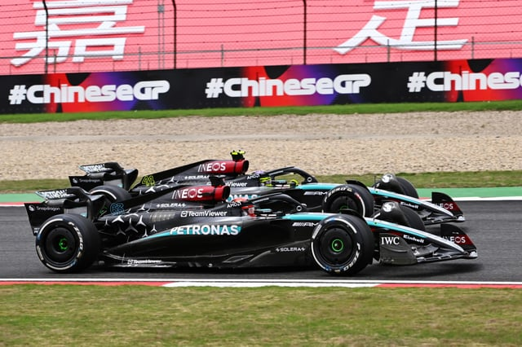
How Many countries participated?
Let’s take a look!

Slide 6
THIS IS A MAP
MENU
ANALYSIS
CONTACT
Data ANALYSIS

Slide 7
01
Final Position V/S Grid Position
MENU
ANALYSIS
CONTACT
Data ANALYSIS
Analysis 1
Grid Position is just the starting position

Slide 8
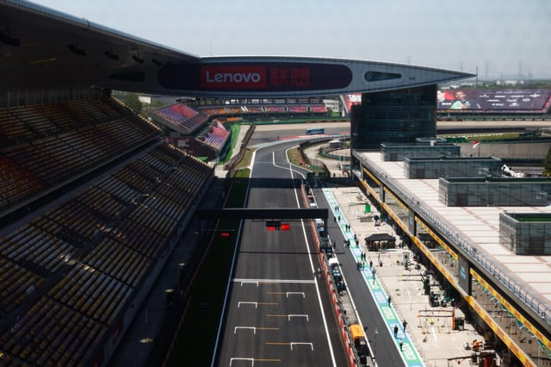
Grid V/S Final
Let’s see how They corelate
MENU
ANALYSIS
CONTACT
Data ANALYSIS

Slide 9
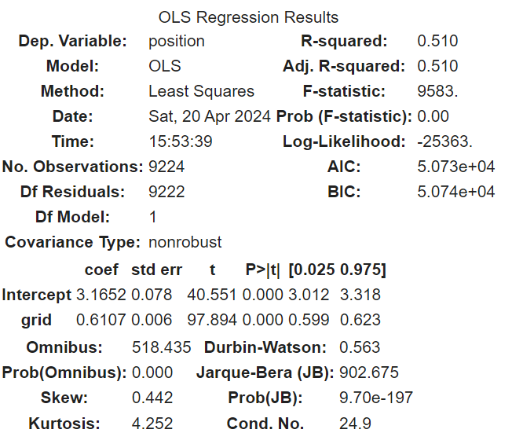
Linear Regression results
MENU
ANALYSIS
CONTACT
Data ANALYSIS

Slide 10

It seems obvious that they will have a good coorelation but Let’s Dive Deeper and Include Constructor (Teams)
MENU
ANALYSIS
CONTACT
Data ANALYSIS

Slide 11
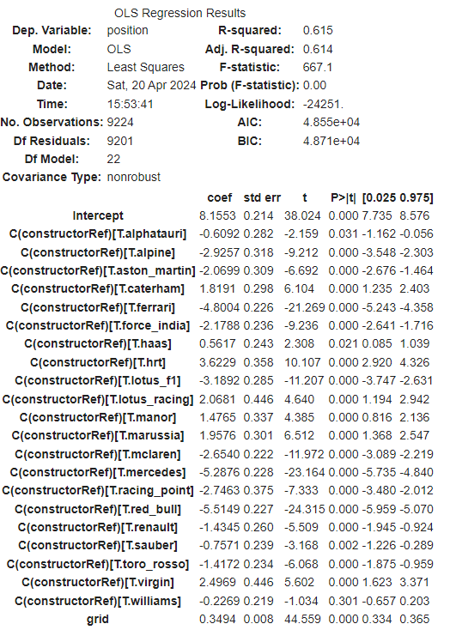
Linear Regression results BETter!
MENU
ANALYSIS
CONTACT
Data ANALYSIS

Slide 12

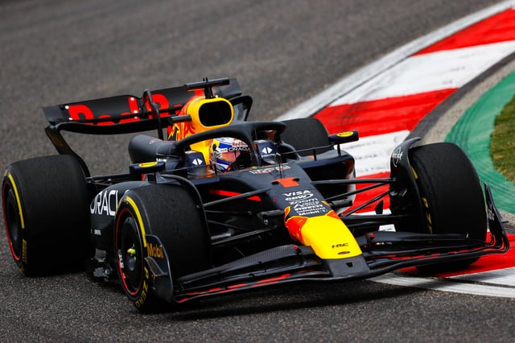
IS WORTH A THOUSAND WORDS
MENU
ANALYSIS
CONTACT
Data ANALYSIS
A PICTURE

Slide 13
Analysis 2: Changes in Engine , Affect Performance?
MENU
ANALYSIS
CONTACT
Data ANALYSIS
Between 2013 and 2014, a decision was made to manipulate the formula of the cars. Starting in 2014, there would be a new V6 engine with 1600cc / 8 gearbox.
Between 2020 and 2021, The key change is that the rear floor, where much of the downforce is generated as the airflow leaves the car, has been narrowed by 100 mm (3.9 inches) just in front of the rear tires. The minimum weight of the cars (without fuel) was also increased from 746 kg to 752

Slide 14
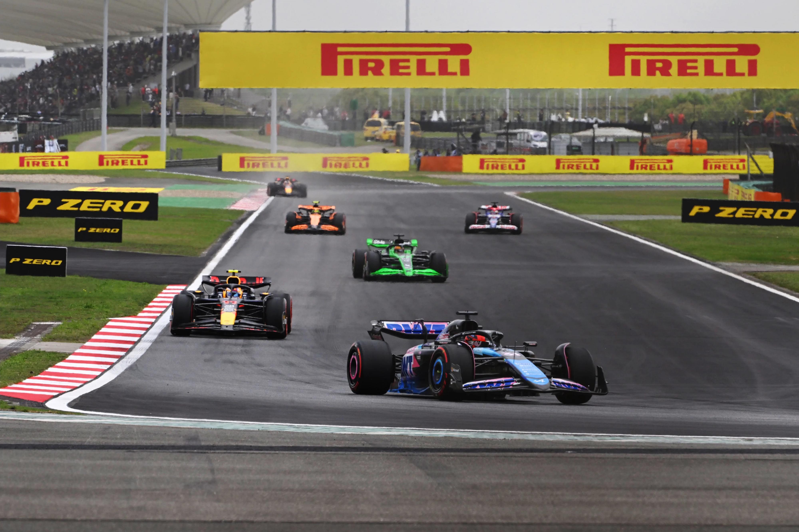
Let’s Take a Look at all of these years and their Comparision
MENU
ANALYSIS
CONTACT
Data ANALYSIS

Slide 15
2013 V/s 2014 2021 V/S 2022
MENU
ANALYSIS
CONTACT
Data ANALYSIS
Big numbers ( Statistical tests)

Slide 16
2013 V/S 2014
2021 V/S 2022
T-statistic: -2.7047322625465324
P-value: 0.006925969052776483
T-statistic: -4.4477655755112115
P-value: 9.328846895903067e-06
2014 V/S 2022
T-statistic: 6.273099137331169
P-value: 0.00041478410312145665
Reject the null hypothesis. There is a significant difference between 2014 and 2022 lap times.

Slide 17

Analysis 3 : Pitstops and Final Position
MENU
ANALYSIS
CONTACT
Data ANALYSIS
Pit stops are a crucial aspect of Formula 1 races and other motorsport events. They are planned breaks during a race where a car pulls into the pit lane for servicing, which typically includes refueling, changing tires, making adjustments, and addressing any mechanical issues. Pit stops are made to optimize the performance and safety of the car, as well as to strategize and gain a competitive advantage during the race.

Slide 18
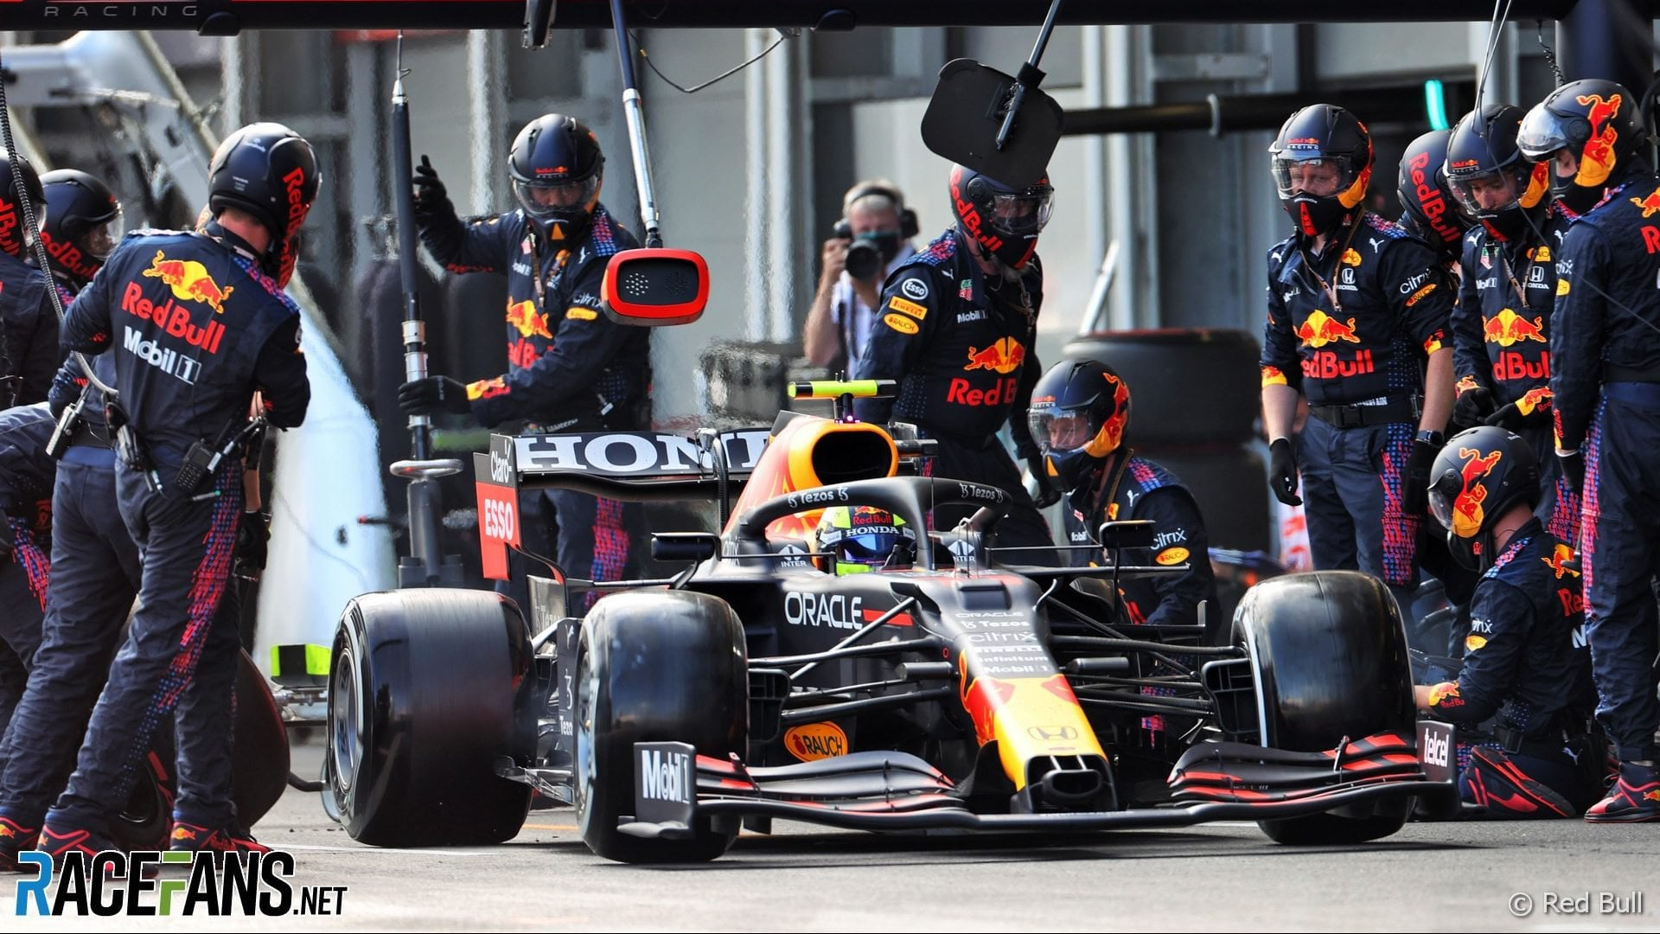
Let’s Take a look at how they are Corelated

Slide 19
A Shocker! Or Maybe Not
MENU
ANALYSIS
CONTACT
Data ANALYSIS
It's not necessarily a shocker, but it could be surprising depending on the expectations or assumptions one might have. In Formula 1 racing, the number of pitstops typically reflects the efficiency of a team's strategy and the performance of the car.
Pearson correlation coefficient: -0.3206792017309289
P-value: 1.3390956706973803e-188
A negative correlation between the number of pitstops and final position suggests that, on average, more pitstops are associated with lower final positions. This could indicate that teams with more pitstops either had issues during the race that necessitated additional stops (such as car problems or tire wear) or employed less effective race strategies.
Low R^2 value (0.103), it indicates that the model explains only a small proportion of the variability in the data. In the context of your analysis, it suggests that while there is a relationship between pitstops and final position, the linear model does not capture all the variability in final position explained by pitstops.
However, interpreting these results warrants caution particularly in distinguishing between causation and correlation. The negative correlation observed does not necessarily mean that increasing the number of pitstops causes a poorer race outcome. There could be underlying variables influencing both the number of pitstops and the race outcome, such as the inherent reliability of the car, the conditions of the track, weather conditions, or even driver skill.

Slide 20

MENU
ANALYSIS
CONTACT
Data ANALYSIS

Slide 21
Analysis 4: Total average points for each country
MENU
ANALYSIS
CONTACT
Moving beyond individual races, I assessed the performance of drivers based on nationality and their cumulative points earned over time. This analysis offers a broader perspective on the performance of different countries in Formula 1 racing and the distribution of success across the globe.

Slide 22
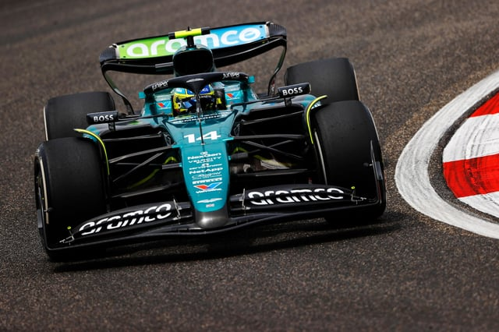
Let’s Take a Look at their Corelation
MENU
ANALYSIS
CONTACT
Data ANALYSIS

Slide 23
Results
MENU
ANALYSIS
CONTACT
Data ANALYSIS
F-statistic: 28.201483012905125
p-value: 7.18537355394048e-171
higher F-statistic suggests that there are significant differences between the means of the groups being compared. In your case, an F-statistic of approximately 28.20 indicates that there are significant differences in the points earned by drivers from different countries. Given the very small p-value and the sizeable F-statistic, you can confidently conclude that there are statistically significant differences in the average points earned by drivers from different countries. This suggests that the nationality of drivers or the characteristics associated with teams from different countries might influence their performance in Formula 1 races.

Slide 24
—SOMEONE FAMOUS
MENU
ANALYSIS
CONTACT
Data ANALYSIS
LETS SEE WHO IS THE BIGGEST LEGEND IS OF ALL TIME IN F1

Slide 25
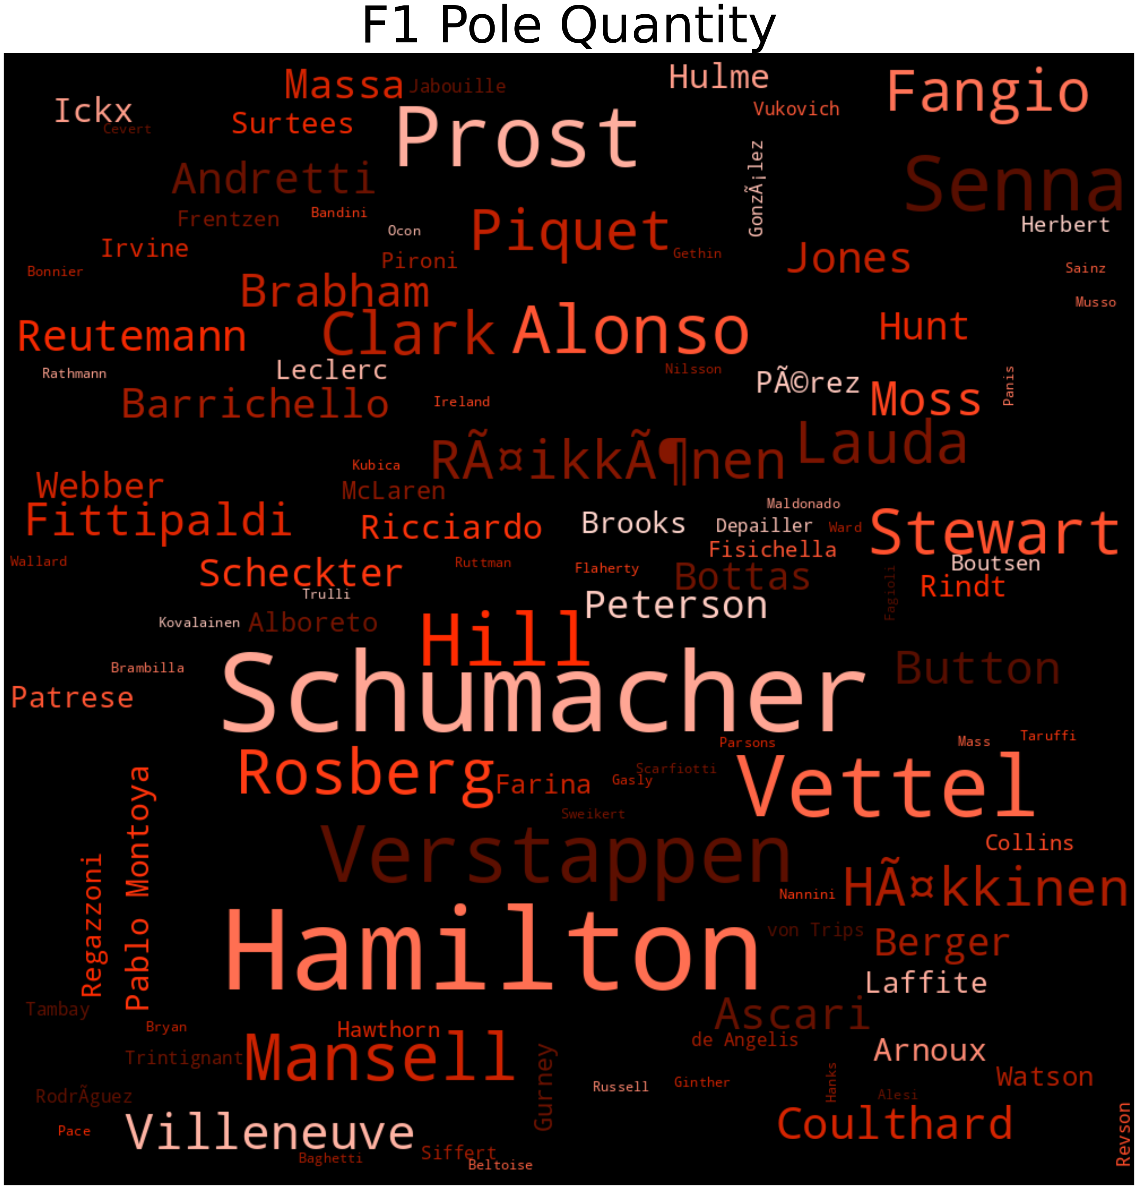
WordClound using pole quantity
MENU
ANALYSIS
CONTACT
Data ANALYSIS

Slide 26
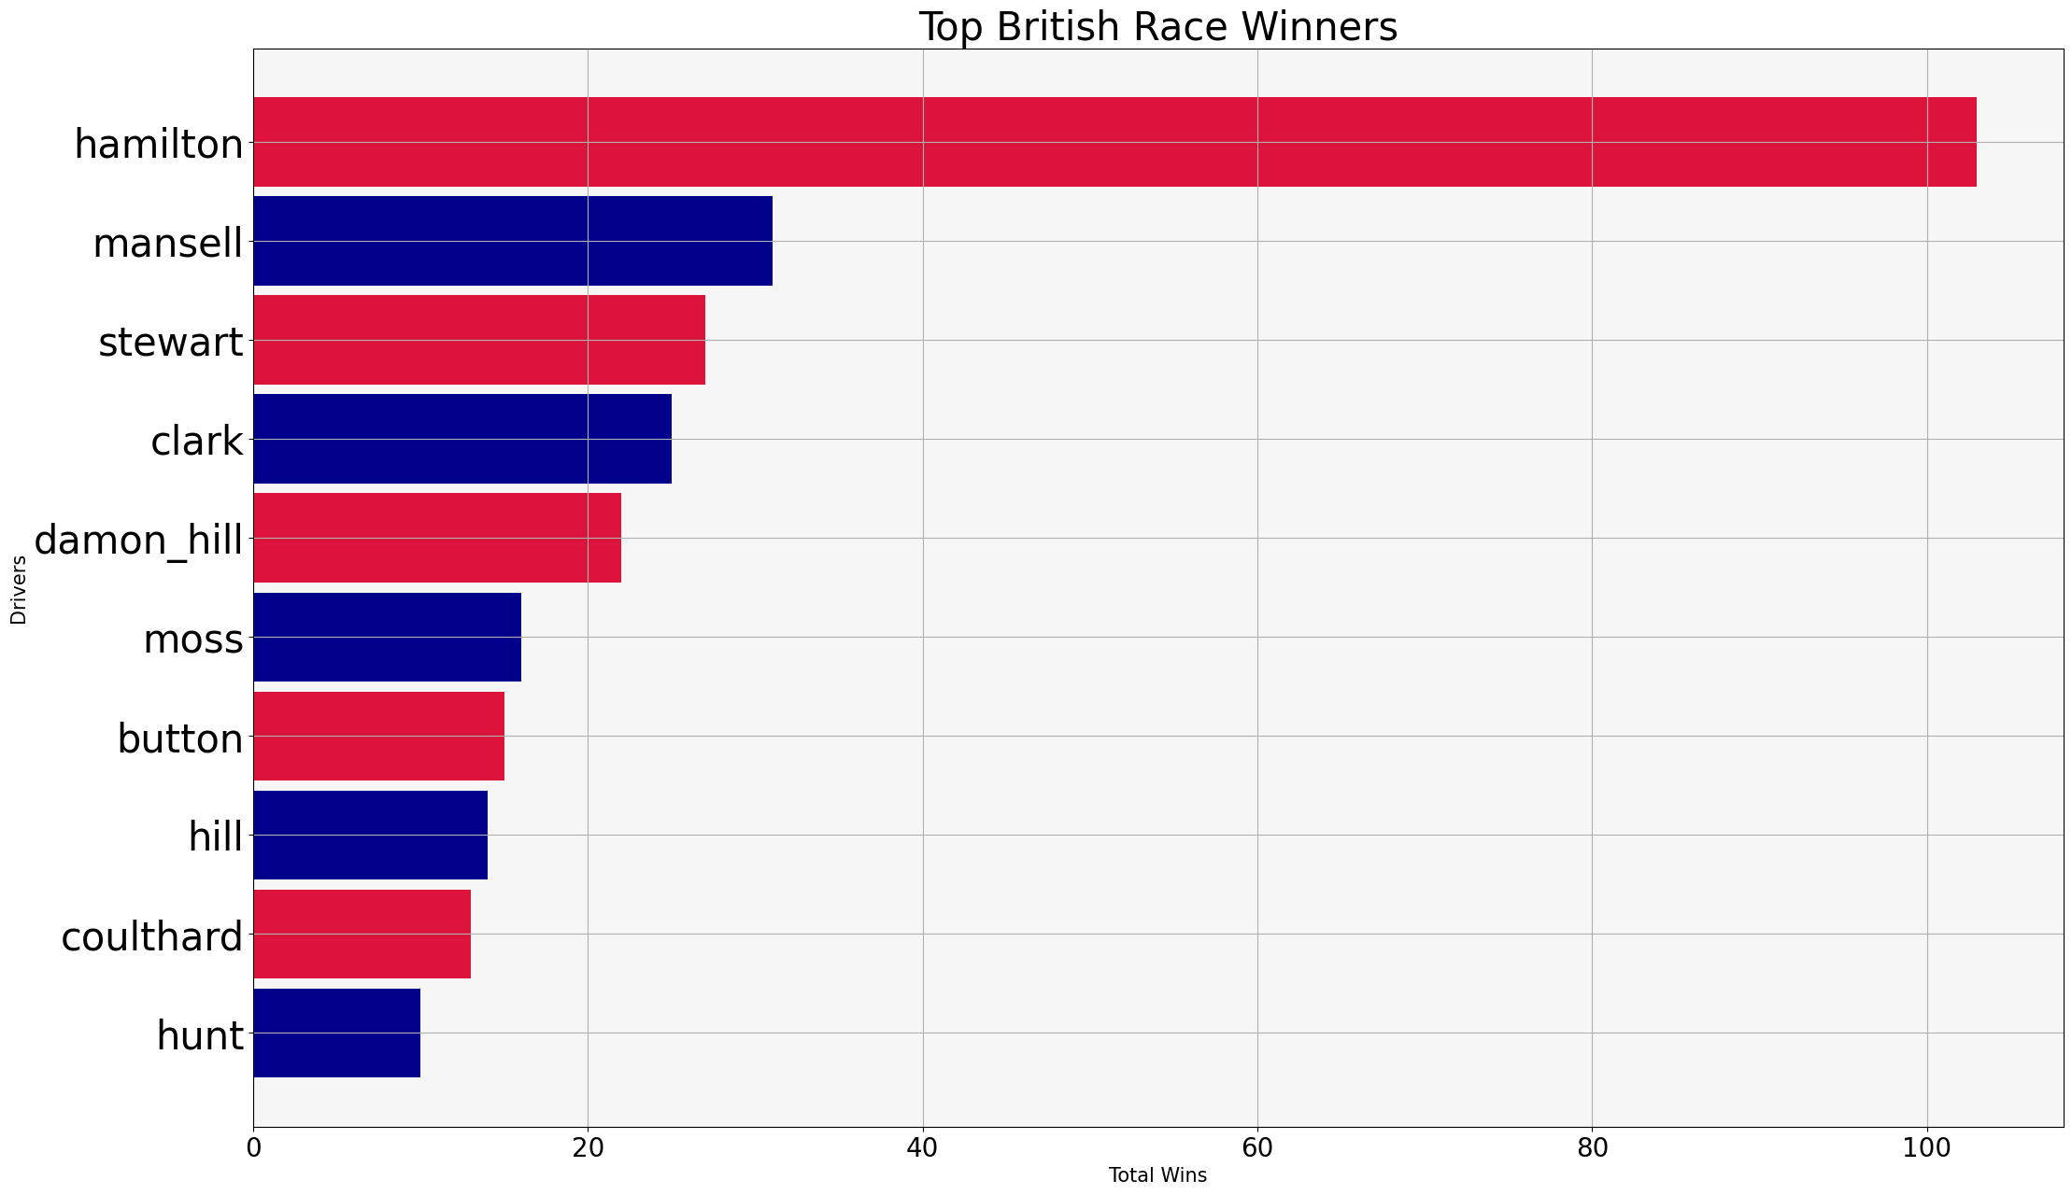
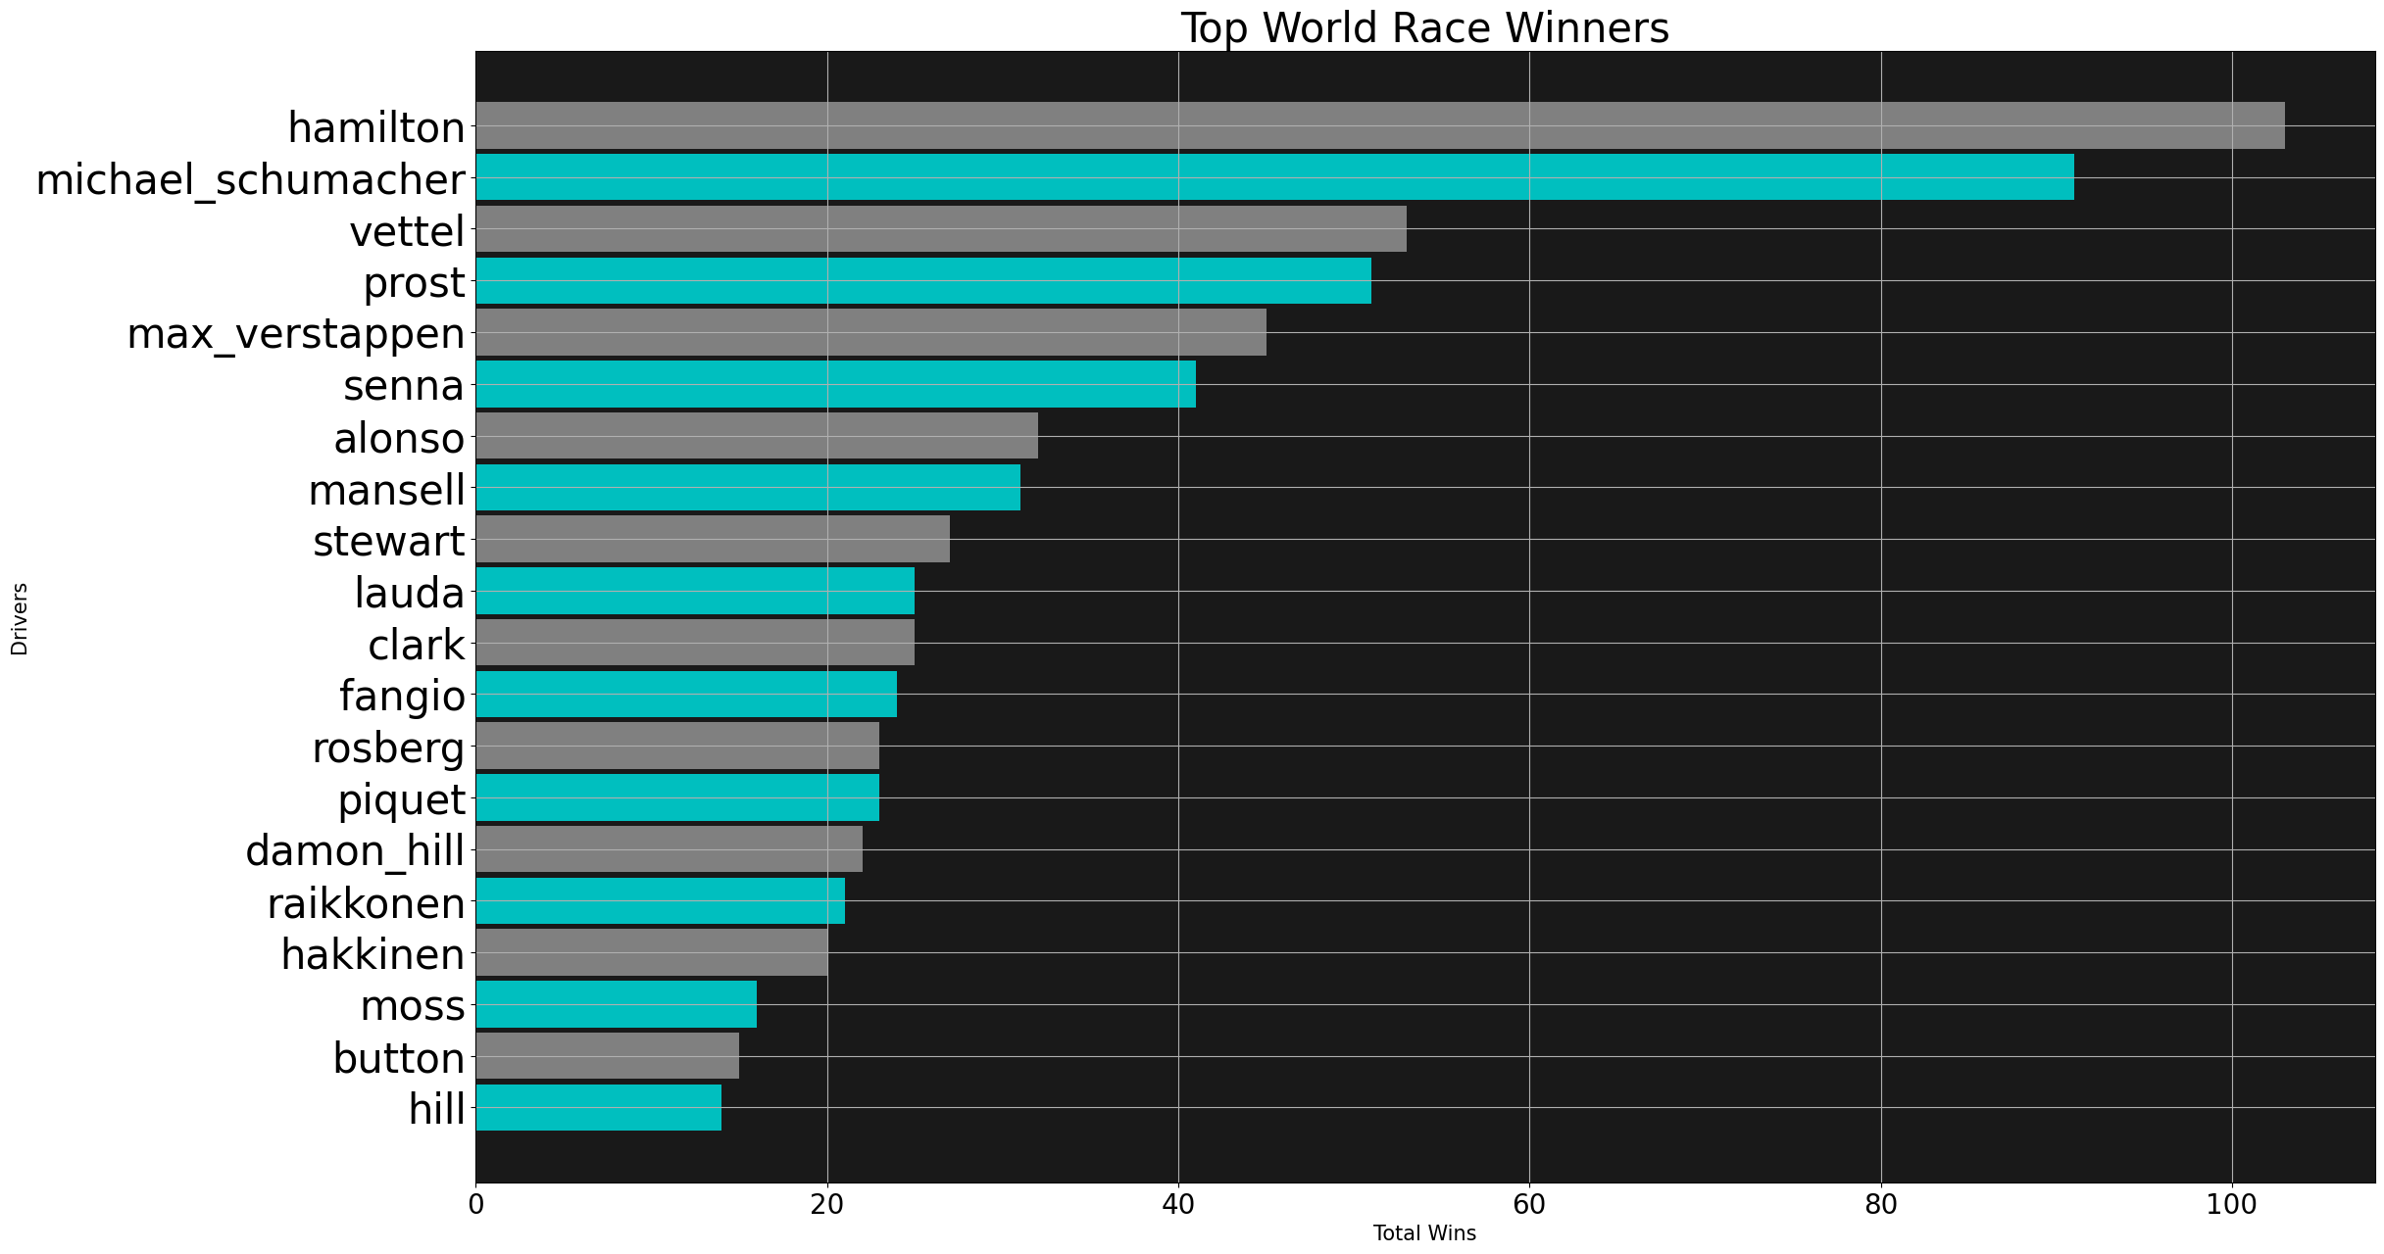
MENU
ANALYSIS
CONTACT
Data ANALYSIS

Slide 27
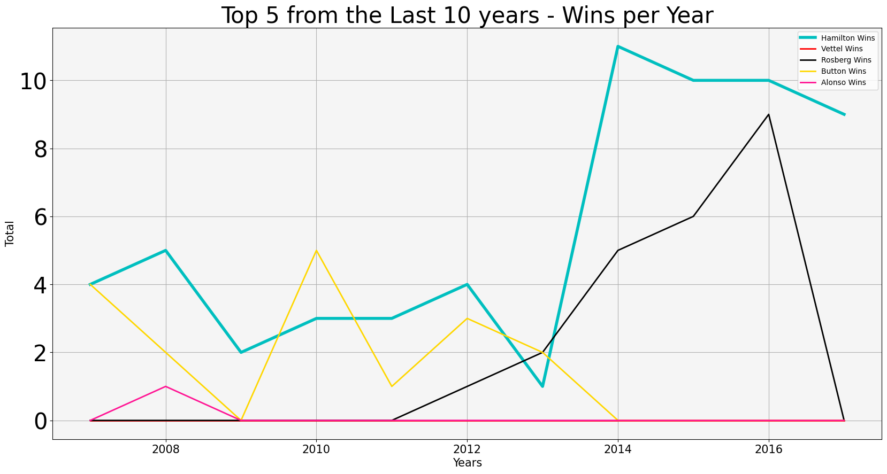
MENU
ANALYSIS
CONTACT
Data ANALYSIS

Slide 28

THE LEGEND SIR LEWIS HAMILTON
MENU
ANALYSIS
CONTACT
Data ANALYSIS
If it’s still not clear the Best of All Time is

Slide 29
Methodologies -
10%
25%
20%
45%
MENU
ANALYSIS
CONTACT
Data ANALYSIS
T test
Linear Regression
F- Statistics
ANOVA

Slide 30
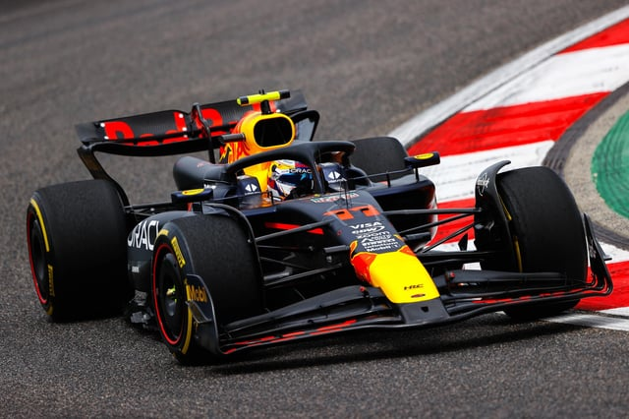
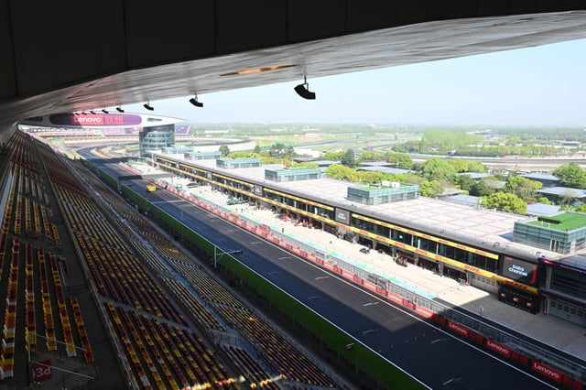
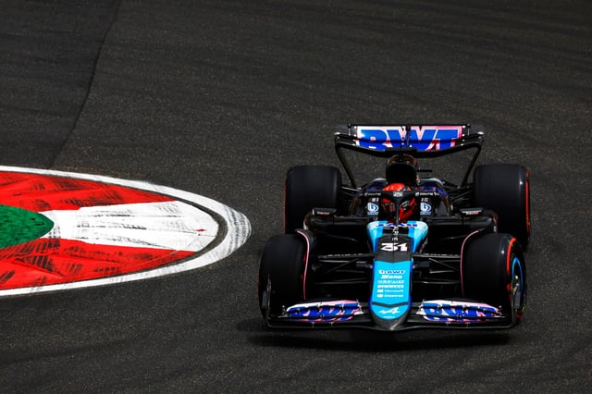
THANKS!
MENU
ANALYSIS
CONTACT
Data ANALYSIS

